Slide 1
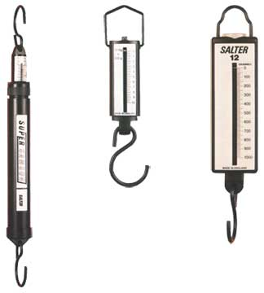
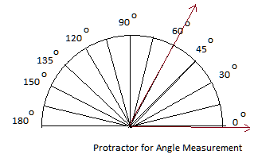

Slide 2
Scientific Notation
Do you know this number, 300,000,000 m/sec?
It's the Speed of light!
Do you recognize this number, 0.000 000 000 753 kg?
This is the mass of a dust particle!
Notes:
1st number coefficient, second number base (always 10)

Slide 3
Scientific Notation
A shorter method to express very large (or very small) numbers
Scientific Notation is based on powers of the base number 10.
Coefficient ( 1 and < 10)
Base ( Always10)
Notes:
1st number coefficient, second number base (always 10)

Slide 4
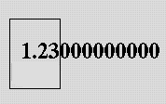
Scientific Notation
Example:
write 123,000,000,000 in S.N.
For coefficient, put the decimal after the first digit and drop the zeroes.
For exponent, count the number of places from the decimal to the end of the number.
Another example:
write .0000000000123 in S.N.
-
Notes:
1st number coefficient, second number base (always 10)

Slide 5
Scientific Notation
Now you try…
Change .0067 to S.N.
Write 3.0 x 10⁸ in decimal notation
Change 3440 to S.N.
Answers…
6.7 x 10⁻³
300,000,000
3.44 x 10³
Notes:
1st number coefficient, second number base (always 10)

Slide 6
SI (Système Internationale a.k.a. Metric) System
A system of measurement based on powers of 10.
It makes unit conversions easy, we simply move the decimal.

Slide 7
For example:
How many feet is 3.5 miles?
3.5mi x 5280ft/mi = 18,480 feet
or
How many meters is 3.5 kilometers?
3.5km x 1000m/km = 3,500 meters
…much easier

Slide 8
The SI “base” units…
Mass
“The amount of matter in an object.”
kilograms (kg)
Volume
“The amount of space taken up by an object.”
meters³ (m³) (although liters (l or L) is sometimes used instead)
Length
“The distance between two points.”
meters (m)
Time
“How long an event occurs.”
Seconds (s)

Slide 9
Metric Conversions
kilo
hecto
deka
deci
centi
milli
k-
h-
D-
Base
d-
c-
m-

Slide 10
Metric Conversions
k-
h-
D-
Base
d-
c-
m-
Count how many places you go from the start to what you want. Move the decimal place that many places and in that direction
Ex. How many meters are in .633 km?
Ex. How many grams are in 5.678 centigrams?

Slide 11
Finding sides & angles with right triangles…
Total degrees = 180º
Pythagorean Theorem
a² + b² = c²
Example: Find the ? side and the θ angle…
θ
15 m
7.5 m
30º
? m
Notes:
Also remind how to find the area of the triangle and Pythagorean theorem

Slide 12
Rearranging equations…
When isolating a variable:
If a constant is added to the variable, subtract the constant from both sides of the equation.
Example: x + 2 = 4
If a constant is subtracted from the variable, add the constant to both sides of the equation.
Example: x – 2 = 4
If a variable is multiplied by a constant, divide both sides of the equation by the constant.
Example: 2x = 4
If a variable is divided by a constant, multiply both sides of the equation by the constant.
Example: x/2 = 4

Slide 13
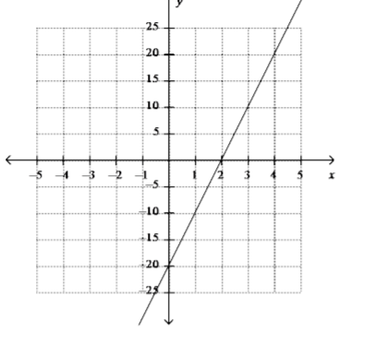
Slope and Area
Finding the area of shapes:
Area of a square/rectangle = base x height
Area of a triangle = 1/2(base x height)
Slope = (y₂ – y₁)/(x₂ – x₁)
Example: Find area of all three shapes and slope of the graphed line.
6 m
6 m
4 m
8 m

