Slide 1
Electric Circuits

Slide 2
Moving electrons
Random movement if circuit is off
Moving electrons come from free electrons in the wires
Kinetic energy of moving electrons causes energy transfer to thermal energy which is why wires get hot.

Slide 3
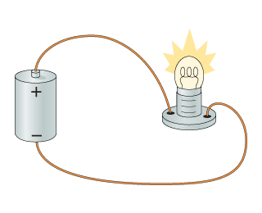
Electric circuit
An electric circuit provides one (or more) complete, closed path(s) through which charges flow.
Circuits form a loop you can trace back to the start.

Slide 4
Electric circuit
Circuits need three basic parts:
Energy source – potential energy
Examples: battery, generator
Wire – provides electrons
Made up of conducting material with low resistance
Example – copper wire one of the best conductors
Load – transforms PE to another form
Examples: light, refrigerator, hair dryer

Slide 5
Electric circuit, cont.
Sometimes, a circuit also contains a switch
Used to control a circuit by opening or closing it
If the switch is open, charges will not flow, if the switch is closed, charges will flow

Slide 6
Electric circuit, cont.
The energy source adds the energy for the electrons to move
The current direction
Electrons move (– to +): negative to positive
Conventional Current moves (+ to –): positive to negative

Slide 7
transfers

Slide 8
Series
Parallel
# of paths: ___
Circuits
# of paths:____
__ varies with R
common parts and characteristics
Same _____ everywhere
Same________ everywhere
__varies with R
on/off :_____ ____________
on/off:______ ___________
Uses:
Uses:

Slide 9
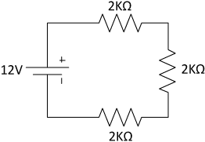
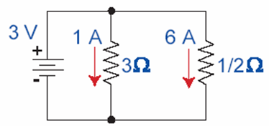
Series Circuit Parallel Circuit
One path
Resistors share voltage (V varies)
Current (I) the same throughout circuit
One part “off”, all parts “off”
More than one path
Each path receives maximum voltage (V the same)
Current varies with resistance of load
Some parts can be “off” while others are “on”

Slide 10
Series Circuit Parallel Circuit
Uses
Burglar alarms
Safety devices
Flashlights (batteries in series)
Uses
Wiring in your home
Lights for a tree
Jump start a car battery (batteries in parallel)

Slide 11
Series
Parallel
more than 1 path/loop
one path/loop
Circuits
Same voltage everywhere
V varies with R
loads, wires, energy sources
Same current everywhere
I varies with R
flowing electrons
Some on while others are off
All on or all off
working = at least 1 closed path
Uses: security alarm,
Uses: home, appliances
safety devices
Notes:
P4 stopped here

Slide 12
Series Circuit

Slide 13
Series Circuit
Advantages
All loads share same current
One continuous path
Disadvantages
Adding more resistance decreases current
A break in one part of circuit causes entire circuit to fail

Slide 14
Parallel Circuit
2.5Ω

Slide 15
Parallel Circuit

Slide 16
Parallel Circuit
Advantages
Loads do not have to have same current
All loads have same amount of voltage going through them
One load loses power, other loads still have power
Disadvantages
Increasing load does not increase resistance which increases chance of an electrical fire

Slide 17
Safety devices
Respond to an overloaded circuit by opening the circuit
Acts like a switch
Examples
Circuit Breaker: flip switch in breaker box
Fuse: must replace

Slide 18
Ohm’s Law
V=IR
Voltage - V
Volt (V)
Battery
Potential difference
Current - I
Amps (A)
Rate of flow
Resistance - R
Ohms (Ω)
As resistance , current

Slide 19
Electric power
P=IV
Current x voltage
Unit
Watts (W)
Kilowatt-hour
Energy delivered in 1 hour at the rate of 1 kW

Slide 20
Energy Transformations
Motor
Electrical Energy Mechanical Energy
Generator
Mechanical Energy Electrical Energy
Hydroelectric Power Plant http://www.fwee.org/walktour/
Mechanical Energy (Water flowing and turning the turbines)
Electrical Energy

Slide 21
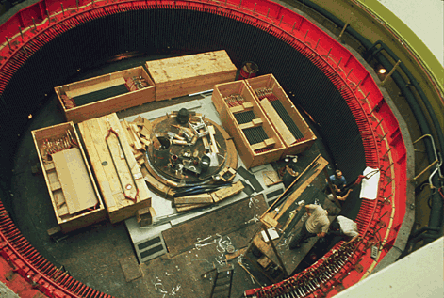
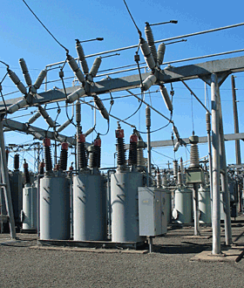
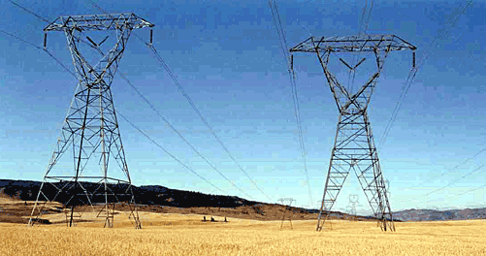
How does electricity get to your house?
THE SPINNING SHAFT turns magnets inside a stationary ring of copper, moving electrons to produce electricity
STEP-UP TRANSFORMERS increase the voltage of electricity produced by the generator.
TRANSMISSON LINES carry electricity to substations in our communities. The voltage is decreased and the power is distributed to homes and businesses

Slide 22
How does electricity get to your house?
THE SPINNING SHAFT turns magnets inside a stationary ring of copper, moving electrons to produce electricity
STEP-UP TRANSFORMERS increase the voltage of electricity produced by the generator.
TRANSMISSON LINES carry electricity to substations in our communities. The voltage is decreased and the power is distributed to homes and businesses

Slide 23
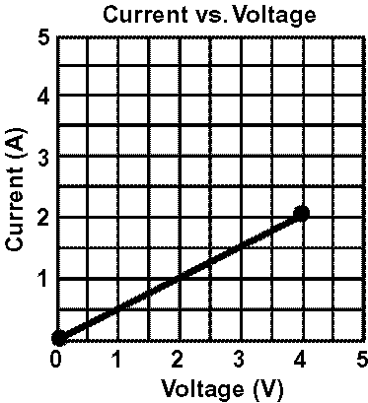
Calculate resistance using the graph.

