Slide 1
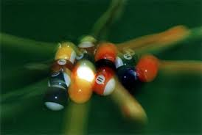
Law of Conservation of Momentum

Slide 2
Law of Conservation of Momentum
If the net external force on a system is zero, then the sum of the momentums of the objects will remain constant.
Σρ_{before} = Σρ_{after}

Slide 3
So when is momentum conserved
In all explosions and collisions, there are no outside forces so momentum is conserved

Slide 4
Explosions
When an object separates suddenly, as in an explosion, all forces are internal.
Momentum is therefore conserved in an explosion.
There is an increase in kinetic energy in an explosion. This comes from a potential energy decrease due to chemical combustion.

Slide 5
Sample problem
Suppose a 5.0-kg projectile launcher shoots a 209 gram projectile at 350 m/s. What is the recoil velocity of the projectile launcher?

Slide 6
Example
A 75-kg man sits in the back of a 120-kg canoe that is at rest in a still pond. If the man begins to move forward in the canoe at 0.50 m/s relative to the shore, what happens to the canoe?

Slide 7
Sample Problem
A firecracker is placed in a pumpkin which explodes into exactly two pieces. The first piece has a mass of 2.2 kg and flies due east at 26 m/s. The second chunk heads due west at 34 m/s. What was the initial mass of the pumpkin?

Slide 8
Collisions
When two moving objects make contact with each other, they undergo a collision.
Conservation of momentum is used to analyze all collisions.
Newton’s Third Law is also useful. It tells us that the force exerted by body A on body B in a collision is equal and opposite to the force exerted on body B by body A.

Slide 9
Collision Types
Elastic collisions
Also called “hard” collisions
No deformation occurs, no kinetic energy lost
Inelastic collisions
Deformation occurs, kinetic energy is lost
Perfectly Inelastic (stick together)
Objects stick together and become one object
Deformation occurs, kinetic energy is lost

Slide 10
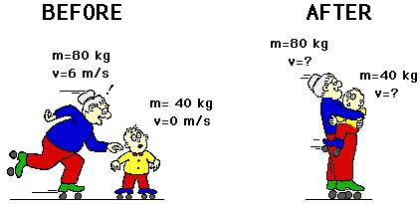
Sample Problem
An 80-kg roller skating grandma collides inelastically with a 40-kg kid. What is their velocity after the collision?
How much kinetic energy is lost?

Slide 11
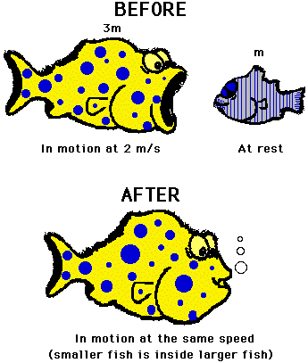
Sample Problem
A fish moving at 2 m/s swallows a stationary fish which is 1/3 its mass. What is the velocity of the big fish after dinner?

Slide 12
Sample problem
A car with a mass of 950 kg and a speed of 16 m/s to the east approaches an intersection. A 1300-kg minivan traveling north at 21 m/s approaches the same intersection. The vehicles collide and stick together. What is the resulting velocity of the vehicles after the collision?

Slide 13
Example
Two carts of equal mass move towards each other with identical speeds of 0.3 m/s. After colliding, the carts bounce off each other, each regaining 0.30 m/s of speed, but now moving in the opposite direction. Is this an elastic collision?

Slide 14
2D-Collisions
Momentum in the x-direction is conserved.
ΣP_{x} (before) = ΣP_{x} (after)
Momentum in the y-direction is conserved.
ΣP_{y} (before) = ΣP_{y} (after)
Treat x and y coordinates independently.
Break momentum into components
Work a problem in x direction
Work a problem in y direction
Put x and y components back together

Slide 15
Sample problem
Calculate velocity of 8-kg ball after the collision.
2.5 m/s
y
y
2 kg
3 m/s
50º
x
x
2 kg
8 kg
0 m/s
8 kg
v
Before
After

Slide 16
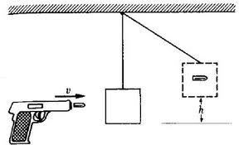
Ballistics Pendulum
A ballistics pendulum was used in munitions factory to test the velocity of the bullets manufactured. A bullet is fired into a block of wood hanging on a string. The height to which the pendulum swings is measured and from this the initial velocity of the bullet can be measured.

Slide 17
Example
A bullet with mass of 0.05 kg is fired into a ballistics pendulum with mass 3 kg. It swings to a height of 0.32 m. What is the velocity of the bullet?

