Slide 1
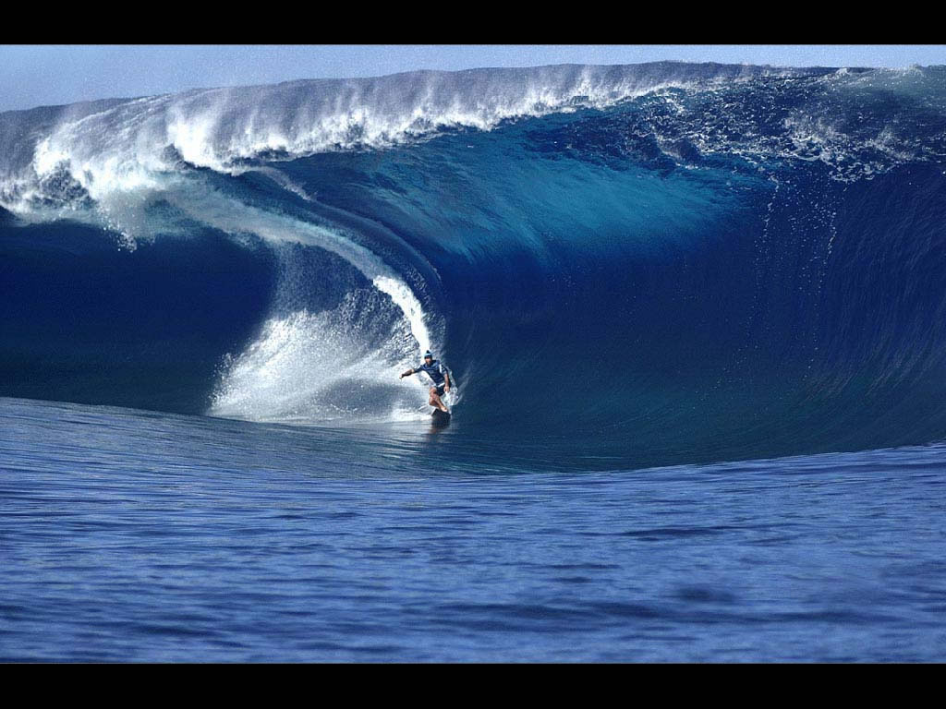
Waves

Slide 2
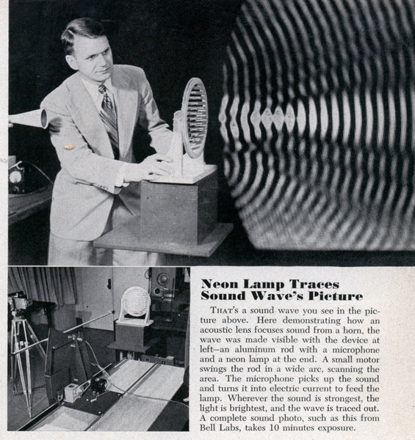
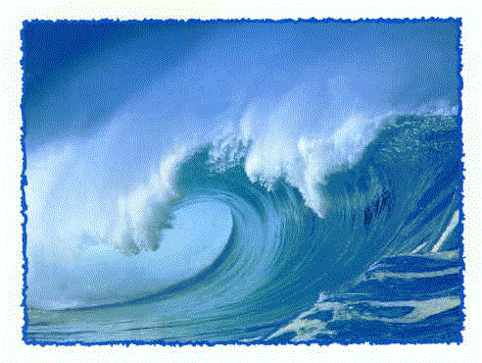
A wave is a disturbance (or vibration) that carries energy from one point to another, but does not carry matter.

Slide 3
Types of waves
http://www.acs.psu.edu/drussell/demos/waves/wavemotion.html

Slide 4
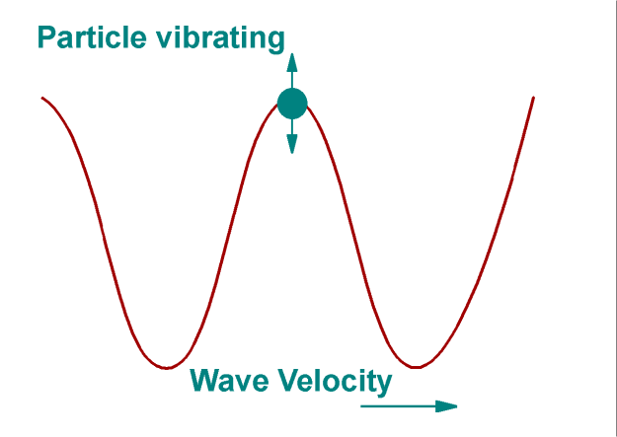
There are 3 types of mechanical waves:
1. Transverse: particles of the medium vibrate perpendicular to the direction of the wave
(ex. light, guitar strings)
http://www.acs.psu.edu/drussell/demos/waves/wavemotion.html

Slide 5
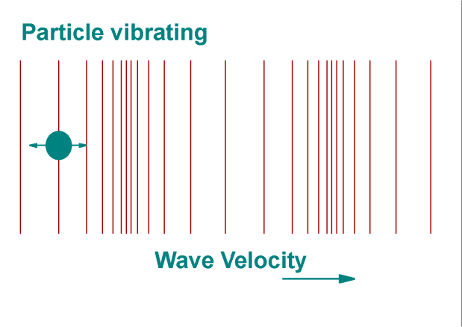
2. Longitudinal: particles of the medium vibrate parallel to the direction of the wave
(ex. sound)
http://www.acs.psu.edu/drussell/demos/waves/wavemotion.html

Slide 6
3. Surface: A mixture of transverse and longitudinal (ex. ocean waves)
http://www.acs.psu.edu/drussell/demos/waves/wavemotion.html
Surface waves are much more complicated
and are not covered in this course!!!

Slide 7
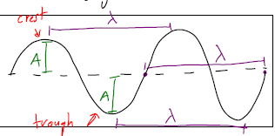
Medium: What the wave travels through
Crest: High point on a wave
Trough: Low point on a wave
Amplitude (A): Max displacement from rest
Wavelength (λ = lambda): distance between two crests (or troughs)

Slide 8
Period and Frequency
Remember that frequency and period are reciprocals
f = 1 T

Slide 9
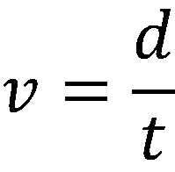
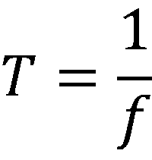
Remember that velocity is:
If we look a single wave then:
the distance (d) is one wavelength (λ)
the time (t) is the period ( )

Slide 10
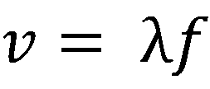
This gives us the Universal Wave Equation:
Where:
v = wave speed (m/s)
λ = wavelength (m)
f = frequency (Hz)

Slide 11
Ex:
Playing middle C on a piano produces a sound with a frequency of 256 Hz. What is the period of the sound wave?

Slide 12
Example:
An air horn sounds at a frequency of 220 Hz. If the speed of sound in air is 330 m/s what is the wavelength of the sound wave?

Slide 13
Example:
The distance between successive crests in a series of water waves is 4.0 m, and the crests travel 8.6 m in 5.0 s.
Calculate the frequency of a block of wood bobbing up and down on these water waves.

Slide 14
Example:
Sound travels at approximately 340 m/s, and light travels at 3.0 x 10⁸ m/s. How far away is a lightning strike if the sound of the thunder arrives at a location 2.0 seconds after the lightning is seen?

Slide 15
http://dev.physicslab.org/Document.aspx?doctype=5&filename=WavesSound_WaveformVibrationGraphs1.xml

