Slide 1
Sound

Slide 2
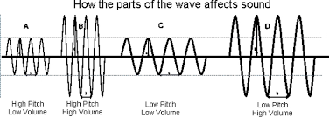
Wave energy
Wave energy depends on amplitude, the more amplitude it has, the more energy it has
Amplitude for sound is volume

Slide 3
Sound is a longitudinal wave
Sound travels through the air at approximately 340 m/s. (It depends on temperature)
It travels through other media as well, often much faster than that!
Sound waves are started by vibration of some other material, which starts the air moving.
Animation courtesy of Dr. Dan Russell, Kettering University

Slide 4
Hearing Sounds
We hear a sound as “high” or “low” depending on its frequency or wavelength.
Sounds with short wavelengths and high frequencies sound high-pitched to our ears, and
sounds with long wavelengths and low frequencies sound low-pitched.
The range of human hearing is from about 20 Hz to about 20,000 Hz.

Slide 5
Doppler Effect
The Doppler Effect is the raising or lowering of the perceived pitch of a sound based on the relative motion of observer and source of the sound.
When a car blowing its horn races toward you, the sound of its horn appears higher in pitch, since the wavelength has been effectively shortened by the motion of the car relative to you.
The opposite happens when the car races away.
https://www.youtube.com/watch?v=yq-QP_95U-0

Slide 6
Doppler Effect
Stationary source
Moving source
Animations courtesy of Dr. Dan Russell, Kettering University
Supersonic source
http://www.lon-capa.org/~mmp/applist/doppler/d.htm

Slide 7
Example
The driver of a car blows the horn as the car approaches you. Compared to the horn’s pitch heard by the driver, will the pitch heard by you be lower, higher, or the same?
After the car passes you, you notice the horn doesn’t sound as loud, is this observation a result of the Doppler effect?

Slide 8
Resonance
Resonance occurs when a vibration from one oscillator occurs at a natural frequency for another oscillator.
The first oscillator will cause the second to vibrate.

Slide 9
https://www.youtube.com/watch?v=pRpN9uLiouI

Slide 10
Beats
“Beats” is the word physicists use to describe the characteristic loud-soft pattern that characterizes two nearly (but not exactly) matched frequencies.
Musicians call this “being out of tune”.

Slide 11
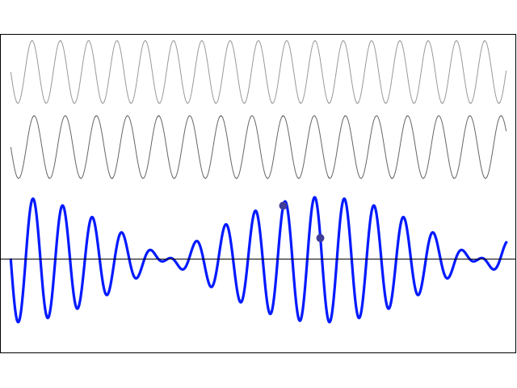
Beats

Slide 12
Beat frequency
Beat frequency is the difference
between the frequencies of the two
waves

Slide 13
Example
A student tunes her guitar by striking a 100 Hz A-note on a tuning fork and simultaneously playing the 5th string on her guitar. Listening closely, she hears the amplitude of the combined sound oscillating twice per second.
What is the current frequency of the 5th string of her guitar?

