Slide 1
WARM-UP
If an object starts at rest and accelerates through a certain distance in a certain amount of time…….
How farther would it go if accelerates for 3 times the amount of time?
How much less time would it take it if accelerates for ½ the distance?
How much farther would it go if it has twice the acceleration?

Slide 2
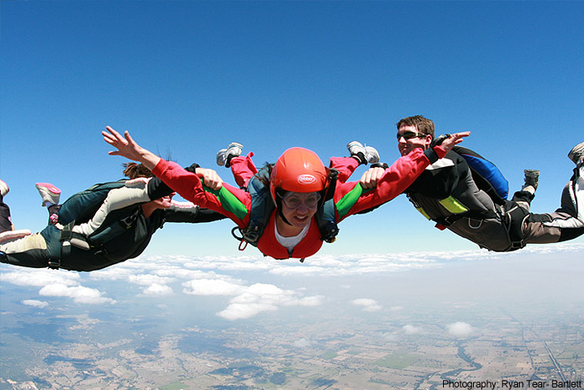
Vertical Motion (Freefall)

Slide 3
Freefall
What is freefall?
Which of the following things do you think are in freefall?
Drop a ball from rest
Toss it upward
Throw it downward
Throw it in an arc to a student
Bounce a ball
Launch it from slingshot
Freefall means the object’s weight (gravity) is the only force acting on it

Slide 4
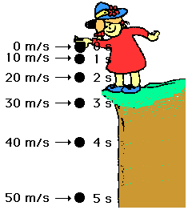
Acceleration due to gravity
toward the ground
Technically, the acceleration is 9.8 m/s², but we will always use 10 m/s²
This means that an
object’s speed increases
by 10 m/s every second

Slide 5
Ranking task

Slide 6
Symmetry in free fall
The up and down trip of an object in freefall is absolutely symmetrical.
The coin spends half of the time rising and half falling.
The speed when the coin returns to the hand equals the speed with which the coin left the hand.
The coin undergoes an acceleration of 10 m/s² during both halves of the trip.
Velocity at the top of the motion = 0 m/s

Slide 7
Air Resistance
Air resistance will be ignored in calculations but may be asked about qualitatively.

Slide 8
Example
A stone is dropped at rest from the top of a cliff. It is observed to hit the ground 5.8 s later. How high is the cliff?
What do I know? | What do I want?
v_{oy}= 0 m/s | Δy = ?
a = -10 m/s²
y_{o}= 0 m
t = 5.8 s
Which variable is NOT given and
NOT asked for?
Final Velocity!
-167.0 m
h =167.0m

Slide 9
Example
You drop a ball from a 120 m high cliff.
a) How long is the ball in the air?
b) What is the ball's velocity at impact?
c) How long does it take to reach the half way point?
d) What is the velocity when the ball has fallen half way
down?

Slide 10
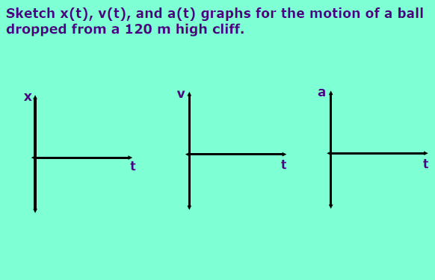

Slide 11
Example
You throw a ball straight up into the air. It leaves your
hand with a velocity of 30 m/s, and you catch it a moment
later.
a) How long is the ball in the air?
b) How high above your hand will the ball rise?
c) What is the velocity of the ball when you catch it?
d) What is the acceleration of the ball at its highest point?

Slide 13
Example
A helicopter is ascending vertically with a speed of 5.00 m/s. At a height of 105 m above the ground, a package is dropped from the window.
How long does it take for the package to hit the ground?

Slide 14
5. A mango is dropped from height y.
If dropped from 2y, what would happen to time in the air?

Slide 15
Designing an experiment
How would you determine the height of a room with only a ball and a stopwatch?

