Slide 1
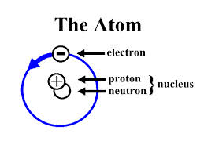
Intro to Electricity
http://www.nmsea.org/Curriculum/4_6/Electricity/dc_electricity.htm

Slide 2
Matter
All matter is made up of small particles called atoms
Inside an atom there are 3 parts
Proton has a positive charge
Electron has a negative charge
Neutron has no charge

Slide 3
Law of Electric Charges
Like charges repel.
Opposite charges attract.

Slide 4
Electric force
Electric Force is the force of attraction (pull) or repulsion (push) on a charged particle

Slide 5
Electric field
Electric Field is the space around a charged object where the electric force applies

Slide 6
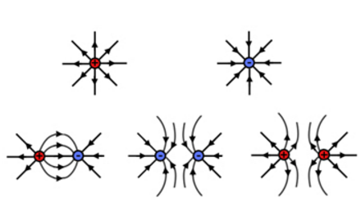

Slide 7
Charge strength
More field lines = stronger force
Less field lines = weaker force

Slide 8
size of electric force
Depends on size of charge
more charge = larger force
Depends on the distance between the charges
more distance = smaller force

Slide 9
gravitational force-vs-electrical force
Gravity
more mass = larger force
more distance between objects
= smaller force
Electricity
more charge = larger force
more distance between objects
= smaller force

Slide 10
Gravity vs electric force
With gravity – force is attractive
With electric fields, force is attractive or repulsive

Slide 11
Moving Charges
Conductor – charges move easily.
Example: copper or any metal

Slide 12
Moving Charges
Insulator – charges do NOT move easily
Examples: plastic, rubber, glass, wood, air

Slide 13
Static electricity
Charges are separated but not moving (at rest).
Electric discharge = release of stored electricity
Example: lightning

Slide 14
Grounded wire
provides a path to the Earth

Slide 15
Electric current
The flow of charged particles.

Slide 16
current
Definition: how fast charges are moving
Unit = ampere
Unit symbol = A

Slide 17
alternating current (AC)
Current flips back and forth continuously.
In US and Canada: flips back and forth 60 time per second
Circle household in your notes.

Slide 18
direct current (DC)
Electrons flow in one direction.
Battery operated devices.
Circle the word batteries in your notes.

Slide 19
voltage
electric potential energy difference
Unit = volt
Unit symbol = V

Slide 20
resistance
Resistance is the opposition to the flow of electric charge
determines amount of current
Unit = ohm
Unit symbol = Ω

Slide 21
resistance
Like electrical friction
Slows flow of electrons

Slide 22
What allows electricity to flow easily?
conductor
low resistance

Slide 23
What does NOT allow electricity to flow easily?
insulator
high resistance

Slide 24
Quantity | Variable | Unit | Unit symbol
current | I | ampere | A
Electric potential (voltage) | V | volt | V
Resistance | R | ohm | Ω

Slide 25
The magnetic field of permanent magnets
http://gamma.nic.fi/~otaina/theory1.htm

Slide 26
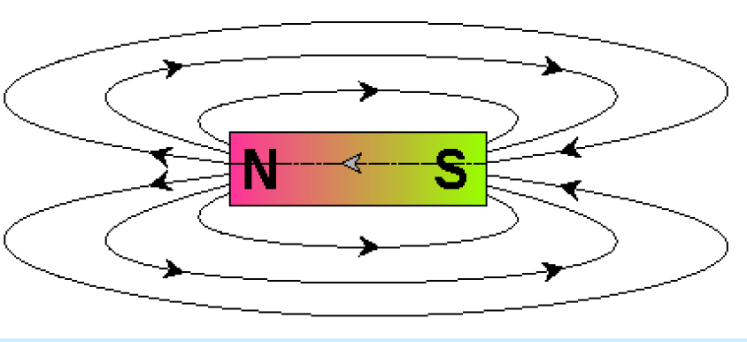

Slide 27
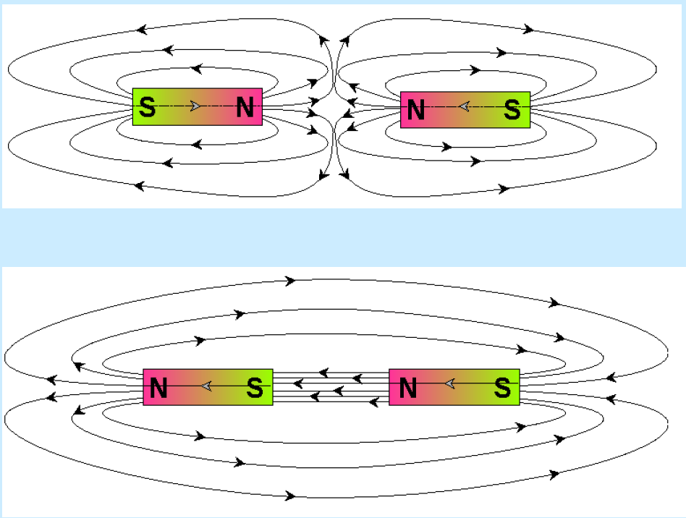

Slide 28
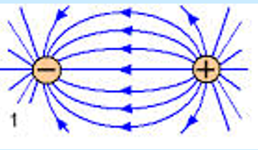
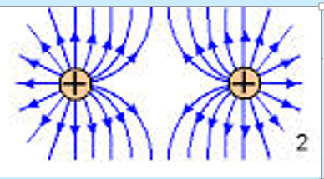
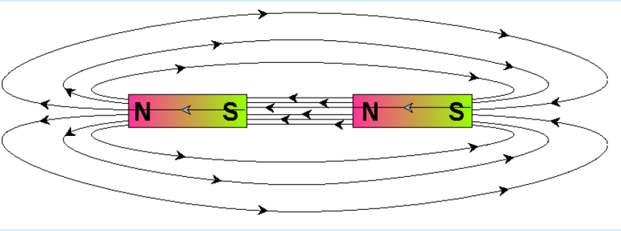
Note similar fields

