Slide 1
Roller Coaster Video Link
http://www.sciencechannel.com/video-topics/engineering-construction/machines-rollercoaster/

Slide 2
Roller Coaster Physics
Make your predictions…
Where is the roller coaster moving the fastest?
Where will the roller coaster be moving the slowest after Point A?
Where will the roller coaster have the greatest amount of energy?
Notes:
Tell them frictionless and the ground is your zero reference point.

Slide 3
We will calculate 2 types of energy
Gravitation potential energy – energy stored due to height
GPE = mgh
Can also be written GPE = F_{w}h
Kinetic energy – energy of motion
KE = ½ mv²
Units for energy is Joules (J)

Slide 4
Roller Coaster Physics
Point A
m = 414.1 kg
h=120
GPE = _____________
KE =____________
Total Energy = _____
Notes:
What they need to know are the equations given throughout and the fact that like momentum energy is conserved in a closed system.

Slide 5
Roller Coaster Physics
m = 414.1 kg
h = 120m
PE = mgh = 486981.6 J
KE = 0 J (no velocity at top of hill)
TE = 486981.6 J

Slide 6
To find energy at other points, use the fact that energy is conserved
This means that total energy is always the same

Slide 7
Roller Coaster Physics
TE = _____@B_________@C
PE = ____@B ____@C
KE = ____@B ____@C
v@C= _____________

Slide 8
Roller Coaster Physics
PE = 243,432J@B 0J @C
KE = 243,509J@B 487,000J@C

Slide 9
Roller Coaster Physics
???
PE = _____
KE = .5mv² = _____
h = _____
v = 30.3 m/s
???
???

Slide 10
Roller Coaster Physics
PE = 296,955J
KE = .5mv² = 190,045J
h = 73.2 m
v = 30.30 m/s

Slide 11
Roller Coaster Physics
???
???
PE = ____@E ____@F
KE = ____@E ____@F
v = ____@E ____@F
???
???
???
???

Slide 12
Roller Coaster Physics
PE = 296,909J
KE = .5mv² = 190,091J
h = 73.2 m
v = 30.30 m/s
Mass = 414.1 kg
PE = mgh = 487,000J
KE =0 J
h = 120 m
PE = 243,490J@B 0J @C
KE = 243,509J@B 487,000J@C
PE = 162,288J@E 0J@F
KE = 324,712J@E 487,000J@F
v = 39.6 m/s@E 48.5 m/s@F

Slide 13
Roller Coaster Physics
How were your predictions…
Where is the roller coaster moving the fastest?
Where will the roller coaster be moving the slowest?
Where will the roller coaster have the greatest amount of energy?

Slide 14
Potential energy
On a roller coaster the greatest potential energy is at the top of the first hill (highest point)

Slide 15
Kinetic energy (KE)
On a roller coaster the greatest kinetic energy is at the lowest point
This is where the roller coaster has the highest velocity (fastest)

Slide 16
Friction
In reality, friction “steals” some energy throughout the ride
We will ignore this force when doing problems
But its effect is to make the KE less which makes the speed less

Slide 17
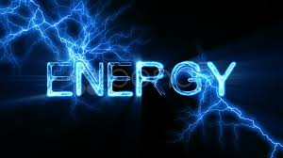
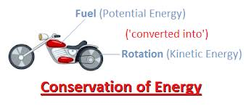
cannot be created or destroyed.
Total amount of energy in a closed system stays the same, but it can be transferred from one type of storage to another.

Slide 18
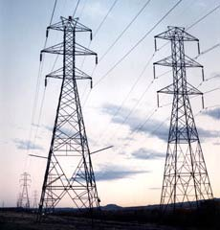
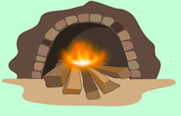
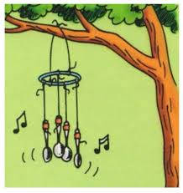
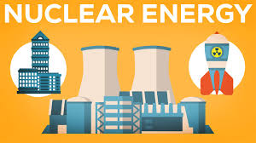
How Is Energy Transferred?
Chemical
Electrical
Radiant or Electromagnetic
Thermal
Mechanical
Sound

Slide 19
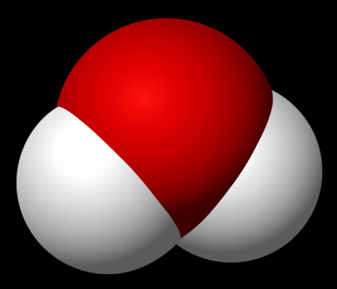
Types of Energy
Chemical
Holds one atom to another atom (chemical bonds)
Type of Potential Energy
Examples:

Slide 20
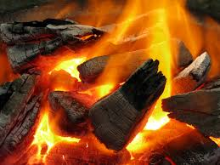
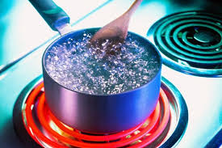
Types of Energy
Thermal
Due to the number of particles and their random motion
Type of Kinetic Energy

Slide 21
Types of Energy
Electrical
Ability to move electrons
Type of Potential Energy
Examples:

Slide 22
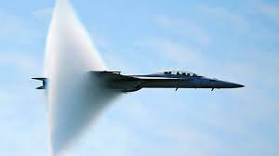
Types of Energy
Sound
Energy of vibrations travelling through matter
Type of Kinetic Energy

Slide 23
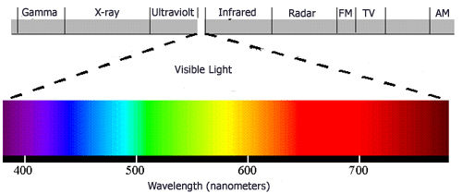
Types of Energy
Electromagnetic (Radiant Energy)
Caused by vibrating electrically charged particles (more later)
Potential Energy

Slide 24
Types of Energy
Elastic
Energy stored in a spring
Potential Energy

Slide 25
Types of Energy
Nuclear
Holds protons and neutrons together in the atom’s nucleus
Type of Potential Energy

Slide 26
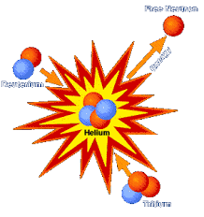
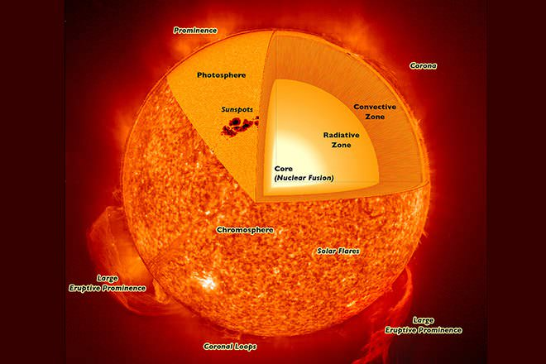
Nuclear Energy
Nuclear Fusion
Two or more atomic nuclei are joined into one single atomic nucleus
http://www.diffen.com/difference/Nuclear_Fission_vs_Nuclear_Fusion
http://krprabakaran.blogspot.com/2011/04/v-behaviorurldefaultvmlo_13.html
https://www.youtube.com/watch?v=Ux33-5k8cjg
Notes:
So why do we have fission power, but not fusion power? The answer is pretty simple, and very frustrating to a lot of physicists out there: For fusion to occur on Earth, you need a temperature of at least 100 million degrees Celsius—six times hotter than the core of the sun. The sun is a natural fusion reactor which makes up for its measly 15 million degrees with the intense pressure created by its core's gravity. Currently, here on Earth the amount of energy you'd need to put in to produce that kind of heat or pressure is much, much higher than what you get out in usable energy.

Slide 27
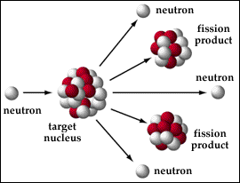
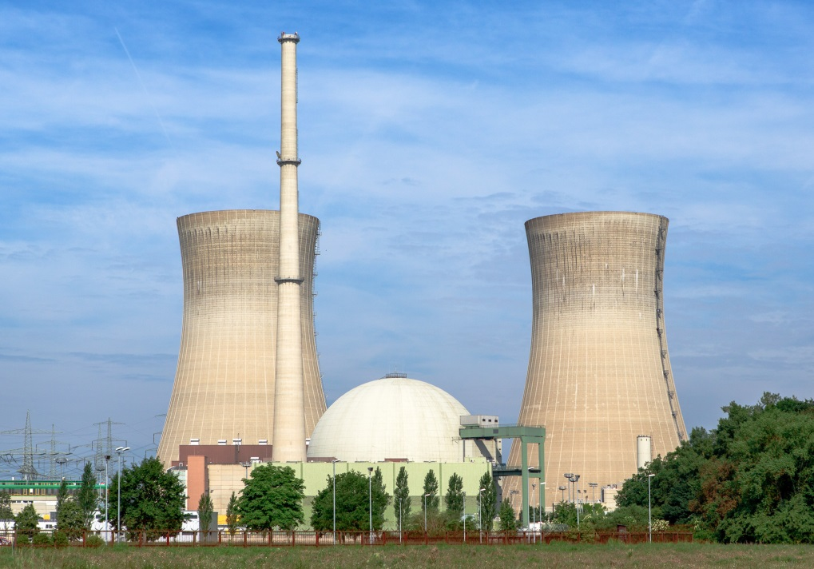
Nuclear Energy
Nuclear Fission
A single atomic nucleus splits into two or more smaller atomic nuclei
https://myweb.rollins.edu/jsiry/Fissiondefine.html
https://en.wikipedia.org/wiki/Nuclear_power_plant#/media/File:Kernkraftwerk_Grafenrheinfeld_-_2013.jpg
http://www.diffen.com/difference/Nuclear_Fission_vs_Nuclear_Fusion

Slide 28
No Perfect Energy Transfer
Friction always causes some energy to transfer into thermal energy (heat) in EVERY energy conversion
Often this form of energy is not useful to us

Slide 29
Mechanical Energy – the energy of an object or system due to its motion or position.
Potential Energy
Kinetic Energy
KE
Gravitation GPE
Elastic EPE

Slide 30
Total Mechanical Energy (TME)
Total Mechanical Energy
PE
KE
GPE
EPE

Slide 31
Conservation of Mechanical Energy
0 Reference Point
System: Cart, Track, Earth
GPE
GPE
KE
KE
Point A
Point B
Point C

