Slide 1

Waves
An Introduction

Slide 2
Waves Flip Book
Get 1 full page and 1 half page of paper
Fold full sheet of paper
about 1-1.5” short of even
Insert half sheet in the middle
Staple across the fold
Pick up the top two pages and starting from the bottom, cut the top two
pages in half.
(Do Not Cut Bottom Sheet)

Slide 3
Flip Book: Titles
Mechanical Waves
Electromagnetic Waves
Notes:
Good info http://factmyth.com/mechanical-waves-versus-electromagnetic-waves/

Slide 4
Flip Book: Tab 1
Definitions
Mechanical Waves
Electromagnetic Waves
Waves through matter - disruption of the matter
The matter is called the medium
Travel faster thru denser medium
Waves that do not require a medium – electromagnetic energy
Can travel
through outer space
Slow down thru denser medium
Notes:
Mechanical waves aren’t made out of anything. They are the disruption of a medium. Just like a wave in water, the wave is pressure displacing water; it isn’t itself a thing. There is no widget, just an effect. Electromagnetic waves, on the other hand, are made out of something, electromagnetic energy. There are only four forces in the universe. The most important by many measures is electromagnetic energy.

Slide 5
Flip Book: Tab 2
Examples
Mechanical Waves
Electromagnetic Waves
Sound waves
Ocean waves
Seismic waves
Slinky waves
Jump rope waves
Gamma waves
X-rays
Ultraviolet waves
Visible light
Infrared
Microwaves
Radio/TV waves

Slide 6
Waves Flip Book #2
Get 1 white sheet and 1 color sheet of paper
Offset top and bottom sheet by 1”
Fold both sheets of paper offset
so you see four edges (tabs)
Staple across the fold
Pick up the top three pages and
starting from the bottom, cut the top
three pages in half.
(Do Not Cut Bottom Sheet)

Slide 7
Flip Book: Titles
Transverse Waves
Longitudinal Waves

Slide 8
Flip Book: Tab 1
Direction of Motion
Transverse Waves
Longitudinal Waves
Perpendicular
(at 90 degree angle) to wave direction
Same as (parallel to) wave direction

Slide 9
Flip Book: Tab 2
Picture
Transverse Waves
Longitudinal Waves
Draw transverse wave and label
  Crest
  Trough
  Rest position
  Amplitude
  Wavelength
  Node & Antinode
Draw longitudinal waves and label
  Rarefaction
  Compression
  Wavelength

Slide 10
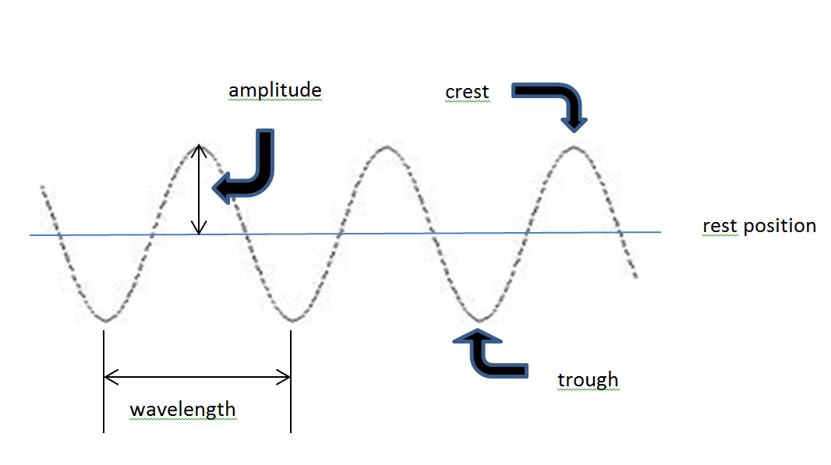
Transverse Wave
crest
amplitude
antinode
node
antinode
trough
wavelength

Slide 11
Flip Book: Tab 2
Picture
Transverse Waves
Longitudinal Waves
Draw transverse wave and label
  Crest
  Trough
  Rest position
  Amplitude
  Wavelength
  Node & Antinode
Draw longitudinal waves and label
  Rarefaction
  Compression
  Wavelength

Slide 12
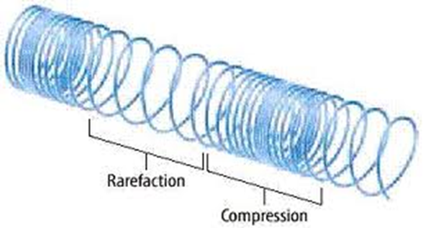
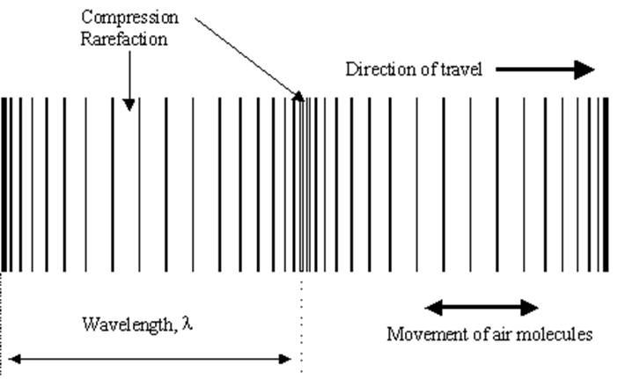
Longitudinal Wave
http://www.proprofs.com/quiz-school/upload/
yuiupload/12404989.jpg
Compression
Rarefaction
http://www.sinequanonthebook.com/AetherHistory.html

Slide 13
Flip Book: Tab 3
Wave Part Definitions
Transverse Waves
Longitudinal Waves
Crest
Trough
Rest position
Amplitude
Wavelength
Rarefaction
Compression
Wavelength
Notes:
Mechanical waves can propagate as longitudinal waves, transverse waves, or surface waves, but electromagnetic waves can only propagate as transverse waves.

Slide 14

Flip Book: On back
Surface Waves
  Form at or near boundary of two media
  Combination of transverse and longitudinal wave
  Particles move in circles
Notes:
Perhaps you have seen seaweed washed ashore by breaking waves. As a wave enters shallow water, it topples over on itself because friction with the shore slows down the bottom of the wave. The top of the wave continues forward at its original speed. As a result, the wave carries the medium, along with anything floating in it, toward the shore.

Slide 15
Waves
&
Simple Harmonic Motion

Slide 16

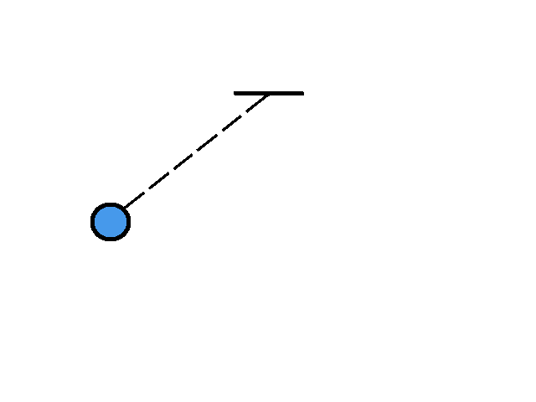
Simple Harmonic Motion
Any periodically repeating event.
(Ex: waves, pendulums, heartbeats, etc.)
https://ibeconsphysics.files.wordpress.com/2012/10/gif-blue-shm-100ms.gif

Slide 17
Waves
Disturbances in space and time which repeat regularly and
transfer energy
without actually transporting the
matter it propagates through.
Medium = the matter a wave is traveling through

Slide 18
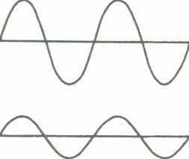
Two Types of Waves
Transverse:
  particle motion is ┴ to the motion of energy transfer.
wavelength (λ)
Amount of energy carried by a wave is related to amplitude
amplitude
nodes
antinodes

Slide 19
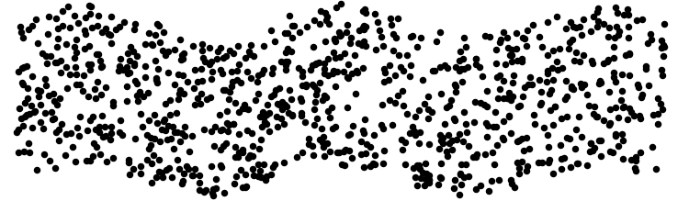
Two Types of Waves
Transverse:
  particle motion is ┴ to the motion of energy transfer.
http://www.phy.ntnu.edu.tw/ntnujava/index.php?topic=148

Slide 20
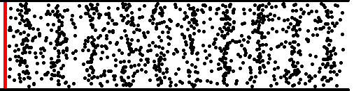
Two Types of Waves (cont’d)
Longitudinal: particle motion is ║ to the motion of energy transfer.
  ‘compressions’ and ‘rarefactions’
  like sound waves
http://www.phy.ntnu.edu.tw/ntnujava/index.php?topic=148

Slide 21
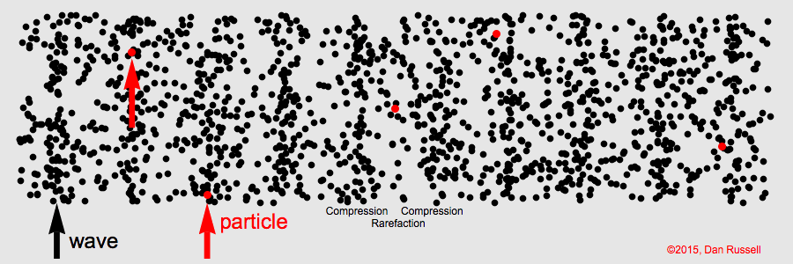
Two Types of Waves (cont’d)
Longitudinal: particle motion is ║ to the motion of energy transfer.
http://www.phy.ntnu.edu.tw/ntnujava/index.php?topic=148

Slide 22
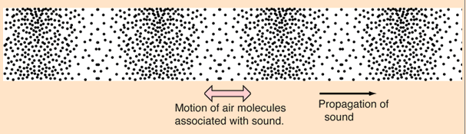
Two Types of Waves (cont’d)
Longitudinal: particle motion is ║ to the motion of energy transfer.
compression: more dense,
particles close together
rarefaction: less dense,
particles far apart
http://hyperphysics.phy-astr.gsu.edu/hbase/sound/tralon.html#c2

Slide 23
Measuring Periodic Motion
Frequency (f):
  Number of waves produced in a given time period (cycles per second)
  UNIT: hertz (Hz)
Period (T):
  seconds per cycle
  UNIT: seconds (s)
Back and forth…
f = 1 / T
T = 1 / f
Inversely proportional

Slide 24
Wave Speed
Depends ONLY on the medium
  Mechanical waves travel faster in more dense mediums (solid >liquid>gas)
  Mechanical waves travel faster through warmer matter
  Mechanical waves travel faster in mediums with more elasticity

Slide 25
Wave Speed
v = λ f
velocity (m/s)
frequency (Hz)
wavelength (m)

Slide 26
Try These…
Ocean waves are 8 m long and one passes by you every 4 seconds.
What is the wave’s period?
What is the wave’s frequency?
What is the speed of the wave?
Notes:
T = 4s f = .25 Hz v = 8m(.25Hz) = 2 m/s

Slide 27
Another one…
Ocean waves move at 4 m/s and 3 waves pass by you every 15 seconds.
What is the wave’s speed?
What is the wave’s frequency?
What is the wavelength?
Notes:
V = 4 m/s f = 3/15 = .2Hz wavelength = 4m/s/.2Hz = 20 m

Slide 28
Intensity
Intensity is the variance of waves by change of amplitude (volume in sound).
Notice that these two waves have the same frequency, but different intensities.
Which one has the higher volume?
Notes:
intensity doesn't so much measure the amount of energy transferred as it measures the rate at which this energy is transferred

Slide 29
Pitch
Pitch is the variance of waves by change of frequency.
Notice that these two waves have the same Intensity, but different frequencies.
Which one has the higher pitch?

Slide 30
Sound (Mechanical Wave)
MEDIUM:
∆ FREQUENCY:
∆ AMPLITUDE:
SPEED:
Solid / Liquid / Gas
∆ pitch
∆ volume
≈340 m/s
-depends on density and temperature of medium
-density ↑, velocity ↑
-temperature ↑, velocity ↑

Slide 31
Light (Electromagnetic Wave)
MEDIUM:
∆ FREQUENCY:
∆ AMPLITUDE:
SPEED:
Does not require medium.
∆ color
∆ brightness
≈300,000,000 m/s (in a vacuum)
-depends on density of medium
--density ↑, velocity
-the one true constant in the universe
↑

Slide 32
Resonance
Every object has a natural frequency at which the object begins to vibrate. If it happens to be exposed to sound waves at this frequency, it will instantly begin to vibrate. This is resonance.
Let’s learn more about Resonance Modes here: https://www.youtube.com/watch?v=wYoxOJDrZzw
http://www.youtube.com/watch?v=3mclp9QmCGs
https://www.youtube.com/watch?v=6ai2QFxStxo
Notes:
When you tune your radio, you are adjusting the natural frequency of the electronics in the radio to match one of the many incoming signals resonating the radio to one station at a time instead of playing all the stations at once.

Slide 33
Wave Interactions
Reflection
Refraction
Diffraction
Interference
  Constructive
  Destructive
Doppler effect

Slide 34
Wave Interactions
reflection
  bouncing of waves off of an obstacle
refraction
  bending of waves upon entering a new medium
diffraction
  the bending of waves around an obstacle, edge or opening
Interference
  adding and subtracting amplitudes of waves which are out of phase
Doppler Effect
  apparent change in frequency of a source due to relative motion

Slide 35
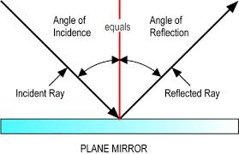
Reflection
bouncing of waves off of an obstacle
Examples: mirrors, echoes, sonar
http://images.tutorvista.com/cms/images/101/plane-mirror.png

Slide 36
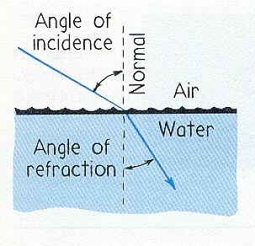
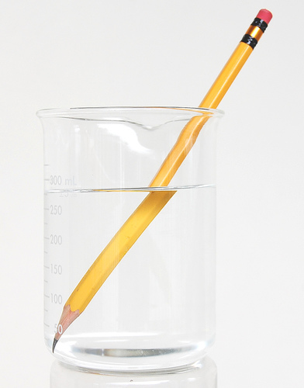
Refraction
bending of waves upon entering a new medium
Examples: prism, rainbow, mirages
http://electron9.phys.utk.edu/optics421/modules/m1/images/refractionlaw.jpg
http://farm2.static.flickr.com/1219/738579428_21f9b1d9c4.jpg
Notes:
Hot air less dense than cool air so lower index of refraction (light travels faster through it).

Slide 37
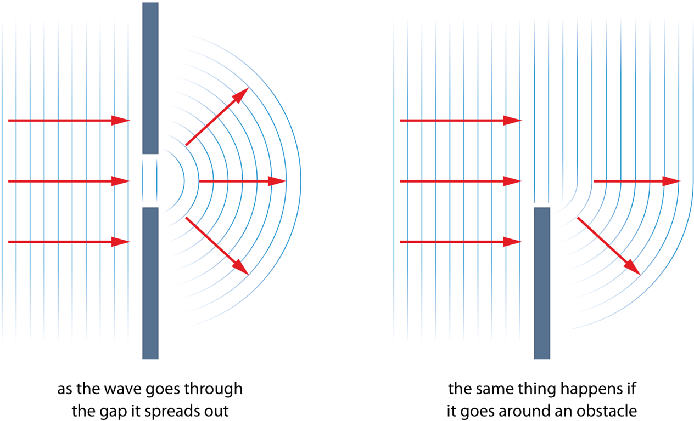
Diffraction
the bending of waves around an obstacle
http://physics.taskermilward.org.uk/KS4/core/waves/wave_behaviour/diffraction.png
https://www.youtube.com/watch?v=fwXQjRBLwsQ https://www.youtube.com/watch?v=Iuv6hY6zsd0
Notes:
Examples: hologram on credit card, iridescence of deli meat, rainbow pattern when look at a cd

Slide 38
Interference
adding and subtracting amplitudes of waves which are out of phase
Constructive Interference
  Two crests overlap and their amplitudes add together
  Two troughs overlap and their amplitudes add together
Examples: rogue ocean waves, loud spots from
speakers
http://zonalandeducation.com/mstm/physics/waves/interference/constructiveInterference/InterferenceExplanation2.html
Notes:
Rogue waves (ocean waves), double slit experiment (constructive and destructive), loud areas from speakers (sound waves)

Slide 39
Interference
adding and subtracting amplitudes of waves which are out of phase
Destructive Interference
  A crest and a trough overlap resulting in a decrease or a cancellation of the amplitude
Examples: noise cancelling headphones, quiet
spots from speakers, antireflection
coating on lenses
  http://zonalandeducation.com/mstm/physics/waves/interference/destructiveInterference/InterferenceExplanation3.html
  http://zonalandeducation.com/mstm/physics/waves/interference/waveInterference2/WaveInterference2.html

Slide 40
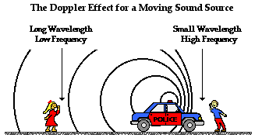
Doppler Effect
apparent change in frequency of a source due to relative motion
http://www.physicsclassroom.com/Class/waves/u10l3d3.gif
http://highered.mheducation.com/olcweb/cgi/pluginpop.cgi?it=swf::800::600::/sites/dl/free/0072482621/78778/Doppler_Nav.swf::Doppler+Shift+Interactive
https://www.youtube.com/watch?v=gWGLAAYdbbc
https://www.youtube.com/watch?v=yq-QP_95U-0

Slide 41
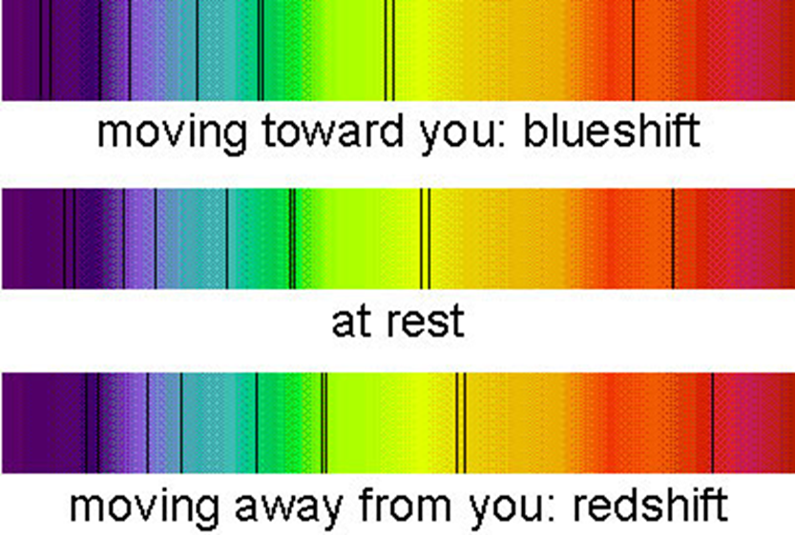
Doppler Effect
http://cosmology.net/images/redshift111.jpg

Slide 42
Edwin Hubble hypothesis (1929)
All interstellar objects (far away galaxies) are red shifted. (Data) measured by Vesto Slipher (1917)
Therefore: All objects are moving away from us and each other. (Conclusion)
Therefore: The universe is expanding. (Hypothesis)

