Slide 2
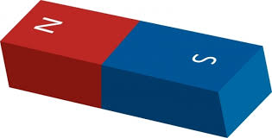
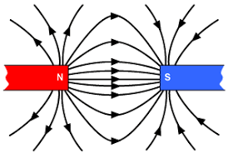
Magnets
Have a north and south pole
Magnetic field moves from north towards south

Slide 3
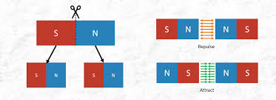
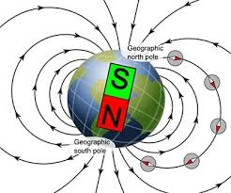
More on magnets
If you break a magnet in half, each new piece will have a north and south pole
The earth is a big magnet, the magnetic north pole is located at the geographic south pole.

Slide 4
Intro to Electromagnetism
What is electric current?
Flowing electrons
What does an electric current cause?
A magnetic field
The direction of the magnetic field is at a 90º angle to the direction of the electrical charge.
B field
+

Slide 5
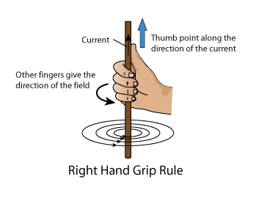
Right Hand Rule (RHR)
The thumb points in the direction of the current
The curved fingers give the direction of the magnetic field
What shape does the magnetic field trace out around the wire?
http://bp0.blogger.com/_PyvjcvYfRLk/SFnpDI55a4I/AAAAAAAAAEQ/hiFS_Z2Nwk0/s1600/Right-Hand-Grip-Rules.png

Slide 6
Right Hand Rule (RHR)
In order to display the magnetic field more easily, some texts use a symbolic display similar to an arrow.
X means into the page and · means out of the page.
· · · · · · · · · · · · · · · · · · · · · · · · · · · · · · · · · · · · · · · · · · · · · · · · · · · · ·
x x x x x x x x x x x x x x x x

Slide 7
Right Hand Rule (RHR)
Around a wire
Around a loop
http://t1.gstatic.com/images?q=tbn:ANd9GcTqG8_Kq9OgcyDT5FuNfXZbO7HLFjlDKJ4JddiJvHVw9nyNVxLETg
http://t0.gstatic.com/images?q=tbn:ANd9GcTmT-LFgUZKkPJIn6c7Kpq_lLiEzwy58bC-5-3Ee8RZlZH58C1iNw

Slide 8
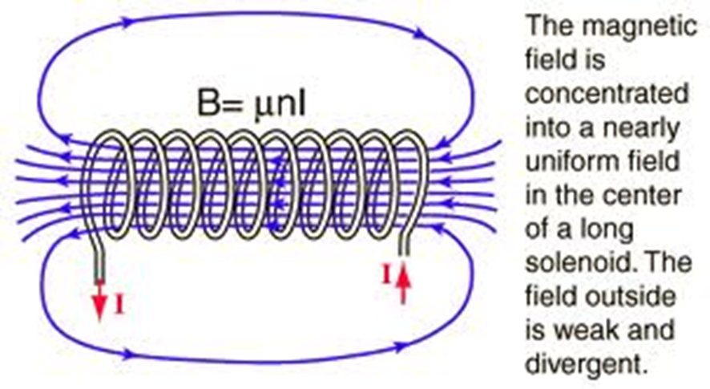
Solenoid
A solenoid is a coil of wire
Electrons flowing in the coil create a magnet.
http://hyperphysics.phy-astr.gsu.edu/hbase/magnetic/imgmag/sol3.gif
Notes:
B=magnetic field strength
Mu – magnetic permeability
n – number of turns per unit length (turn density)
I - current

Slide 9
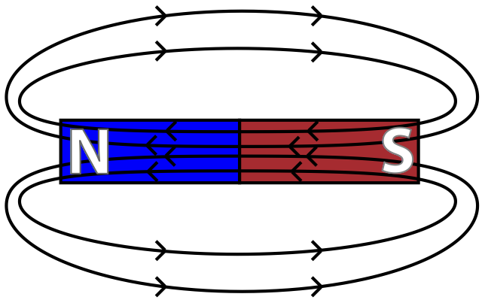
Solenoid vs Magnet
http://hyperphysics.phy-astr.gsu.edu/hbase/magnetic/imgmag/sol3.gif
http://www.aplusphysics.com/courses/honors/magnets/magfields.html

Slide 10
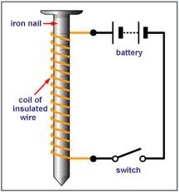
Electromagnet
A solenoid wrapped around an iron core
The magnetic field inside iron magnifies the solenoid’s field
More loops = stronger electromagnet
More current = stronger electromagnet
http://hyperphysics.phy-astr.gsu.edu/hbase/magnetic/imgmag/sol3.gif

Slide 11
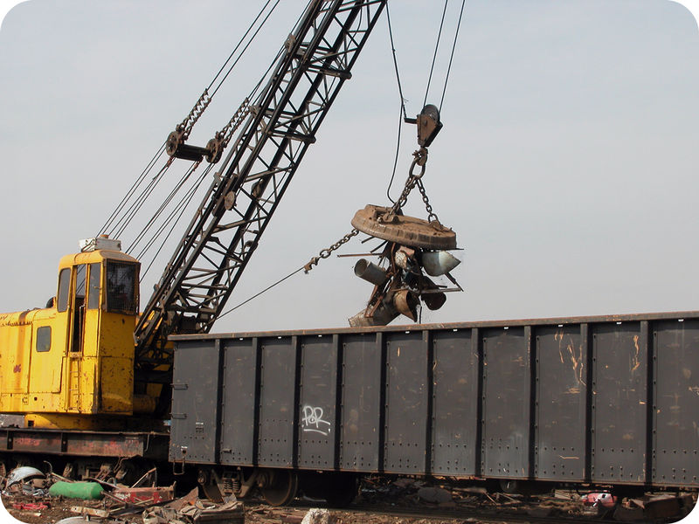
Electromagnet
A magnet that you can turn on and off
https://www.youtube.com/watch?annotation_id=annotation_3566029675&feature=iv&src_vid=hFAOXdXZ5TM&v=1TKSfAkWWN0

Slide 12
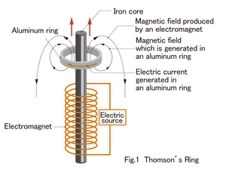
Electromagnet
A magnet that you can turn on and off
Notes:
When electricity suddenly flows through the coil, the ring flies up. Coils are things wound hundreds of times around pins, and when electricity flows, both edges become magnets. However, the ring only jumps an instant when starting to generate electricity. After the electricity starts to flow regularly through the coil, the ring does not fly up. If current was not flowing through the coils, they would not be magnets. Current flows and coils become magnets because of this flow. In other words, at the moment you turn the switch on, something that was not a magnet suddenly becomes one. However, the things that are not magnets turn into magnets only for a moment, and by increasing the magnetic force for a certain time, they can turn into a magnet. During this instant, a change occurs in the ring. The action, which negates a change in the magnetic force of a coil, is produced in the ring. The way the ring negates the change is by generating a magnetic force which counteracts the magnetic force manifesting in the coil. Then, the coil's magnetic force and ring's magnetic force repel each other. The same thing happens when magnets in the North Pole or South Pole face each other. The ring jumps high according to this magnetic repulsion. While the coil magnetic force changes, current flows through the aluminum ring.

Slide 13
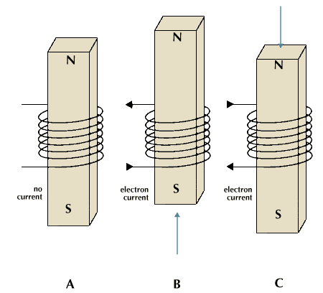
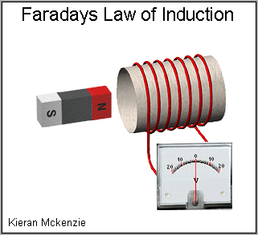
Works other way too!
Magnet moving through a coil of wire creates an electric current.
Animation: http://ap-physics.david-s.org/wp-content/uploads/2015/03/induction-gif.gif
http://media.web.britannica.com/eb-media/73/63373-004-CDB7E548.gif
Notes:
Older link http://micro.magnet.fsu.edu/electromag/java/faraday2/

Slide 14
If you have any two, you make the third
Motion
Current
Magnetism

Slide 15
Energy Transformations
Electric Motor
An alternating current causes a changing magnetic field.
The changing magnetic field causes a magnet to spin.
The magnet is attached to some mechanical device that spins (ex: fan blade)
Energy Transformation:
Electric Potential (V) Mechanical Energy

Slide 16
Energy Transformations
Electric Generator
A spinning magnet causes a change to the electric field.
A changing electric field produces alternating current.
Energy Transformation:
Mechanical Energy Electric Potential (V)

Slide 17
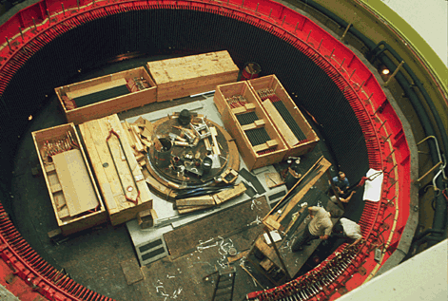
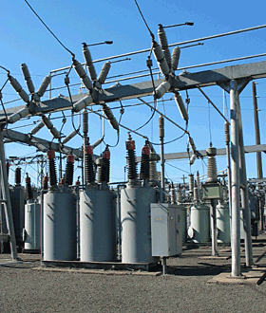
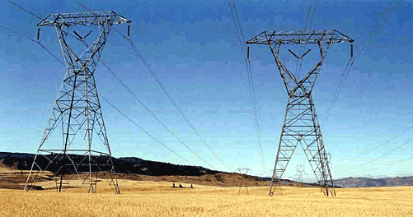
How does electricity get to your house?
THE SPINNING SHAFT turns magnets inside a stationary ring of copper, moving electrons to produce electricity
STEP-UP TRANSFORMERS increase the voltage of electricity produced by the generator.
TRANSMISSON LINES carry electricity to substations in our communities. The voltage is decreased and the power is distributed to homes and businesses

Slide 18
Objects and Fields
Object | Area around the object | Area around the moving object
charged particle | electric field | magnetic field
magnet | magnetic field | electric field

Slide 19
In Summary…
https://www.youtube.com/watch?v=cy6kba3A8vY

