Slide 1
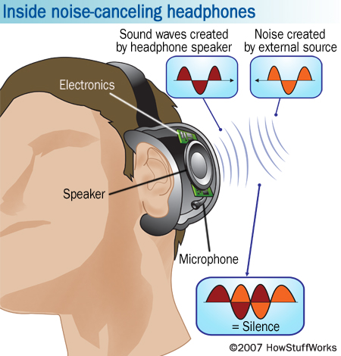
Standing waves

Slide 2
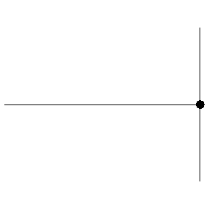
Reflection of waves
Occurs when a wave strikes a medium boundary and “bounces back” into original medium.
Completely reflected waves have the same energy and speed as original wave.

Slide 3
When two waves collide, they don’t bounce or stick like objects do, they interfere
This means they form one wave for a moment and then continue on unchanged
The total amplitude of a wave is equal to the sum of the amplitudes of the individual waves
http://www.acs.psu.edu/drussell/demos/superposition/superposition.html

Slide 4
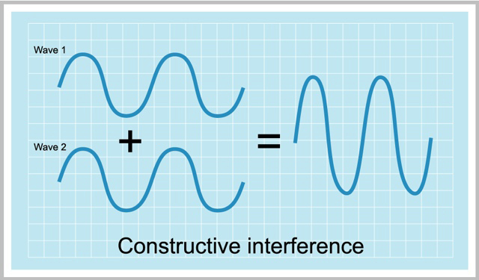
Two waves with the same frequency and phase.
Constructive Interference: add the amplitudes

Slide 5
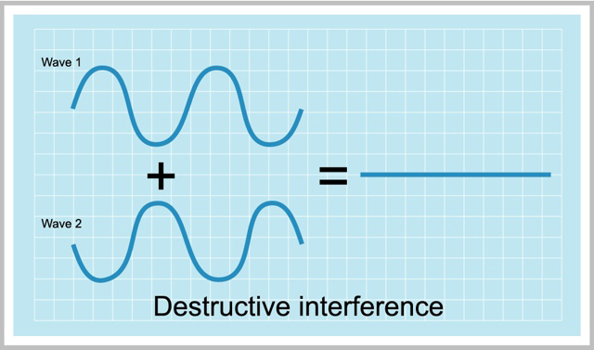
Two waves with same frequency and opposite phase.
Destructive Interference: subtract the amplitudes

Slide 6
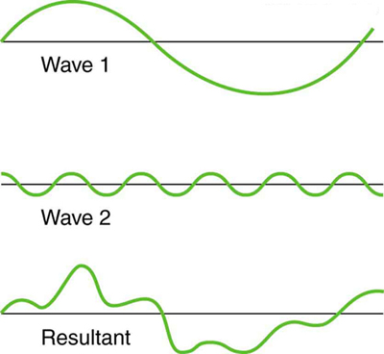
Waves can have constructive and destructive interference at different points.

Slide 7
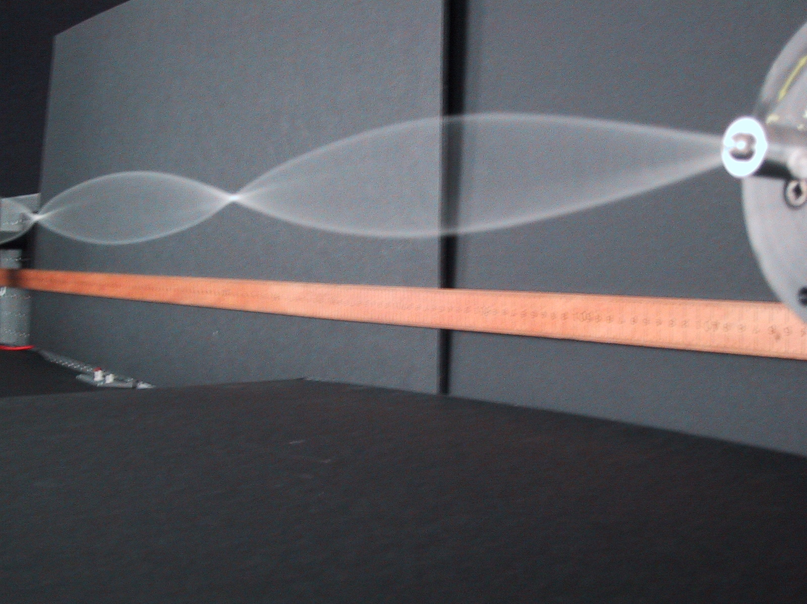
Standing waves

Slide 8
When a wave strikes a fixed boundary it will reflect and invert its amplitude.
If a series of waves are sent along the string the reflected pulse will interfere with the next pulse.
If the waves are sent at just the right frequency we will create a standing wave.
http://www.acs.psu.edu/drussell/demos/superposition/superposition.html

Slide 9
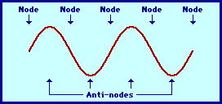
Areas of complete destructive interference have no amplitude and are called nodes.
Areas of complete constructive interference have
large amplitudes
and are called
anti-nodes

Slide 10
Harmonics
Musical instruments vibrate in such a way that a standing wave pattern results
These patterns are only created within the instrument at specific frequencies of vibration; these frequencies are known as harmonic frequencies, or merely harmonics
The first frequency is called the fundamental frequency – it determines the pitch
The higher harmonics are called overtones

Slide 11
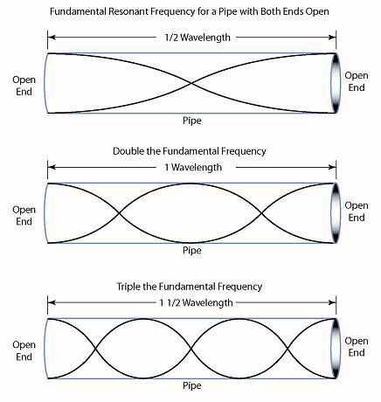
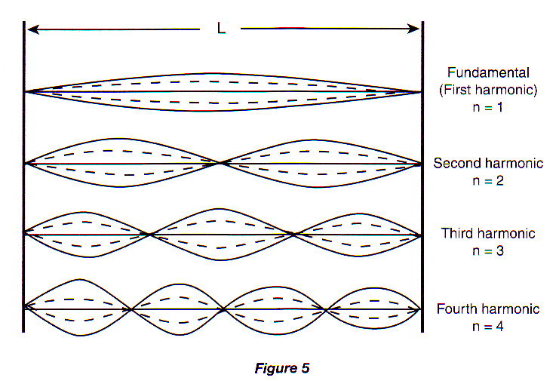
Harmonics – 2 Open ends or 2 fixed ends
Sounds are heard for 2 fixed ends when a node is at the ends, they are heard in 2 open ends when an antinode is at the ends.
In both cases, this first occurs at one-half of a wavelength. This is called the fundamental frequency.
2 open ends 2 fixed ends

Slide 12
Harmonics - FIXED ENDS or 2 open ends

Slide 13
Harmonics – closed at one end, Open at one end
When a tube is open at only one end, you will have an antinode at one end and a node at the other. Each sound you hear will occur when an antinode appears at the open end.
You get your first sound or encounter your first antinode when the length of the pipe is equal to a quarter of a wavelength.

Slide 14
Harmonics – open at one end
You have a NODE at the 2nd harmonic position, therefore NO SOUND is produced

Slide 15
Harmonics – open at one end
You have an ANTINODE at the 3rd harmonic position, therefore SOUND is produced.
CONCLUSION: Sounds in pipes with one open end are produced ONLY at ODD HARMONICS!

Slide 16
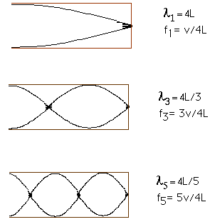
Harmonics - Closed at one end, open at one end

Slide 17
http://www.thephysicsaviary.com/Physics/Programs/Labs/ResonanceTubeLab/index.html

Slide 18
eXAMPLE
How long do you need to make an organ pipe (open at both ends) that produces a fundamental frequency of middle C (256 Hz)? The speed of the sound in air is 340 m/s.
  B) What is the wavelength and frequency of the 2nd harmonic? Draw the standing wave

Slide 19
Example
The windpipe of a typical whooping crane is about 1.525-m long. What is the lowest resonant frequency of this pipe assuming it is a pipe closed at one end? Assume the speed of sound is 353 m/s
57.90 Hz

